Slide 1
PyQt5 asosiy komponentalari
Имя докладчика

Slide 2
Buttons
from PyQt5.QtWidgets import QPushButton
button = QPushButton('PyQt5 button', self)
button.setToolTip('This is an example button')
button.move(100,70)
button.clicked.connect(self.on_click)

Slide 3
QPushButton usul yaratish
def on_click(self):
print('PyQt5 button click')

Slide 4
QMessageBox
from PyQt5.QtWidgets import QMessageBox
QMessageBox.question()

Slide 5
QMessageBox.Yes va QMessageBox.No
buttonReply = QMessageBox.question(self, 'PyQt5 message', "Do you want to save?", QMessageBox.Yes | QMessageBox.No | QMessageBox.Cancel, QMessageBox.Cancel)
print(int(buttonReply))
if buttonReply == QMessageBox.Yes:
print('Yes clicked.')
if buttonReply == QMessageBox.No:
print('No clicked.')
if buttonReply == QMessageBox.Cancel:
print('Cancel')

Slide 6
QMessageBox
QMessageBox.Cancel | QMessageBox.Ok | QMessageBox.Help
QMessageBox.Open | QMessageBox.Save | QMessageBox.SaveAll
QMessageBox.Discard | QMessageBox.Close | QMessageBox.Apply
QMessageBox.Reset | QMessageBox.Yes | QMessageBox.YesToAll
QMessageBox.No | QMessageBox.NoToAll | QMessageBox.NoButton
QMessageBox.RestoreDefaults | QMessageBox.Abort | QMessageBox.Retry
QMessageBox.Ignore

Slide 7
menuBar()
mainMenu = self.menuBar()
fileMenu = mainMenu.addMenu('File')
editMenu = mainMenu.addMenu('Edit')
viewMenu = mainMenu.addMenu('View')
searchMenu = mainMenu.addMenu('Search')
toolsMenu = mainMenu.addMenu('Tools')
helpMenu = mainMenu.addMenu('Help')

Slide 8
Action usulini yaratish
exitButton = QAction(QIcon('exit24.png'), 'Exit', self)
exitButton.setShortcut('Ctrl+Q')
exitButton.setStatusTip('Exit application')
exitButton.triggered.connect(self.close)
fileMenu.addAction(exitButton)

Slide 9
mainMenu = self.menuBar()
fileMenu = mainMenu.addMenu('File')
editMenu = mainMenu.addMenu('Edit')
viewMenu = mainMenu.addMenu('View')
searchMenu = mainMenu.addMenu('Search')
toolsMenu = mainMenu.addMenu('Tools')
helpMenu = mainMenu.addMenu('Help')
exitButton = QAction(QIcon('exit24.png'), 'Exit', self)
exitButton.setShortcut('Ctrl+Q')
exitButton.setStatusTip('Exit application')
exitButton.triggered.connect(self.close)
fileMenu.addAction(exitButton)
self.show()
if __name__ == '__main__':
app = QApplication(sys.argv)
ex = App()
sys.exit(app.exec_())

Slide 10
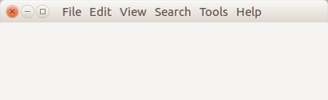
menuBar() - natija

Slide 11
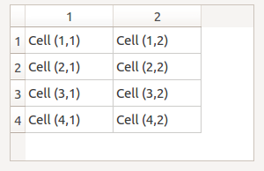
Tables (setRowCount() va setColumnCount())

Slide 12
QTableWidget,QTableWidgetItem
from PyQt5.QtWidgets import QTableWidget,QTableWidgetItem
self.tableWidget = QTableWidget()
# set row count
self.tableWidget.setRowCount(4)
# set column count
self.tableWidget.setColumnCount(2)
# set Item
self.tableWidget.setItem(X,Y, QTableWidgetItem("TEXT"))

Slide 13
def createTable(self):
# Create table
self.tableWidget = QTableWidget()
self.tableWidget.setRowCount(4)
self.tableWidget.setColumnCount(2)
self.tableWidget.setItem(0,0, QTableWidgetItem("Cell (1,1)"))
self.tableWidget.setItem(0,1, QTableWidgetItem("Cell (1,2)"))
self.tableWidget.setItem(1,0, QTableWidgetItem("Cell (2,1)"))
self.tableWidget.setItem(1,1, QTableWidgetItem("Cell (2,2)"))
self.tableWidget.setItem(2,0, QTableWidgetItem("Cell (3,1)"))
self.tableWidget.setItem(2,1, QTableWidgetItem("Cell (3,2)"))
self.tableWidget.setItem(3,0, QTableWidgetItem("Cell (4,1)"))
self.tableWidget.setItem(3,1, QTableWidgetItem("Cell (4,2)"))
self.tableWidget.move(0,0)
# table selection change
self.tableWidget.doubleClicked.connect(self.on_click)

Slide 14
on_click
def on_click(self):
print("\n")
for currentQTableWidgetItem in self.tableWidget.selectedItems():
print(currentQTableWidgetItem.row(), currentQTableWidgetItem.column(), currentQTableWidgetItem.text())

Slide 15
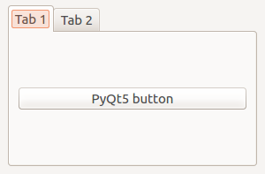
QTabWidget

Slide 16
QTabWidget
class MyTableWidget(QWidget)
self.tabs = QTabWidget()
self.tab1 = QWidget()
self.tab2 = QWidget()
self.tabs.resize(300,200)

Slide 17
# add title
self.tabs.addTab(self.tab1,"Tab 1")
self.tabs.addTab(self.tab2,"Tab 2")
#add contents
self.tab1.layout = QVBoxLayout(self)
self.pushButton1 = QPushButton("PyQt5 button")
self.tab1.layout.addWidget(self.pushButton1)
self.tab1.setLayout(self.tab1.layout)
#Finally
self.layout.addWidget(self.tabs)
self.setLayout(self.layout)

Slide 18
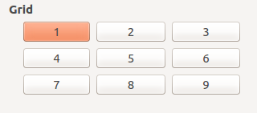
QGridLayout

Slide 19
QGridLayout
from PyQt5.QtWidgets import QGridLayout
createGridLayout()
def createGridLayout(self): self.horizontalGroupBox = QGroupBox("Grid") layout = QGridLayout() layout.setColumnStretch(1, 4) layout.setColumnStretch(2, 4)

Slide 20
#add Widget
layout.addWidget(Widget,X,Y)

Slide 21
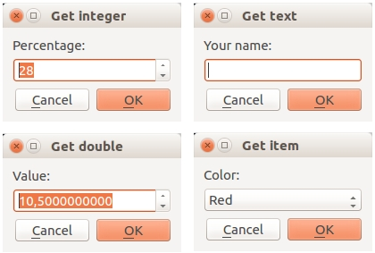
QInputDialog

Slide 22
QInputDialog
from PyQt5.QtWidgets import QInputDialog

Slide 23
QInputDialog.getInt():
def getInteger(self):
i, okPressed = QInputDialog.getInt(self, "Get integer","Percentage:", 28, 0, 100, 1)
if okPressed:
print(i)

Slide 24
QInputDialog.getDouble()
def getDouble(self):
d, okPressed = QInputDialog.getDouble(self, "Get double","Value:", 10.05, 0, 100, 10)
if okPressed:
print(d)

Slide 25
Get item/choice
def getChoice(self):
items = ("Red","Blue","Green")
item, okPressed = QInputDialog.getItem(self, "Get item","Color:", items, 0, False)
if okPressed and item:
print(item)

Slide 26
Get a string
def getText(self):
text, okPressed = QInputDialog.getText(self, "Get text","Your name:", QLineEdit.Normal, "")
if okPressed and text != '':
print(text)

Slide 27
def initUI(self):
self.getInteger()
self.getText()
self.getDouble()
self.getChoice()

Slide 28
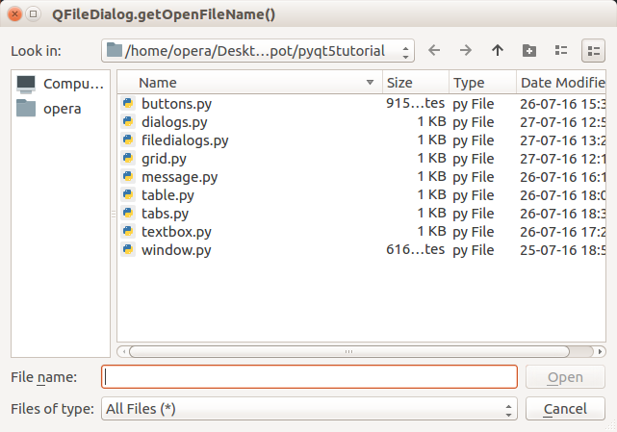
QFileDialog
QFileDialog.getOpenFileName(), QFileDialog.getOpenFileNames(), QFileDialog.getSaveFileName()

Slide 29
QFileDialog init
def initUI(self):
self.setWindowTitle(self.title)
self.setGeometry(self.left, self.top, self.width, self.height)
self.openFileNameDialog()
self.openFileNamesDialog()
self.saveFileDialog()
self.show()

Slide 30
openFileNameDialog(self)
def openFileNameDialog(self):
options = QFileDialog.Options()
options |= QFileDialog.DontUseNativeDialog
fileName, _ = QFileDialog.getOpenFileName(self,"QFileDialog.getOpenFileName()", "","All Files (*);;Python Files (*.py)", options=options)
if fileName:
print(fileName)

Slide 31
openFileNamesDialog()
def openFileNamesDialog(self):
options = QFileDialog.Options()
options |= QFileDialog.DontUseNativeDialog
files, _ = QFileDialog.getOpenFileNames(self,"QFileDialog.getOpenFileNames()", "","All Files (*);;Python Files (*.py)", options=options)
if files:
print(files)

Slide 32
saveFileDialog()
def saveFileDialog(self):
options = QFileDialog.Options()
options |= QFileDialog.DontUseNativeDialog
fileName, _ = QFileDialog.getSaveFileName(self,"QFileDialog.getSaveFileName()","","All Files (*);;Text Files (*.txt)", options=options)
if fileName:
print(fileName)

Slide 33
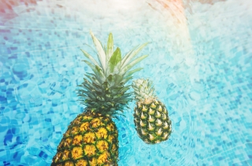
QPixmap

Slide 34
Yaratish
from PyQt5.QtGui import QPixmap
label = QLabel(self)
pixmap = QPixmap('image.jpeg')
label.setPixmap(pixmap)
# Optional, resize window to image size
self.resize(pixmap.width(),pixmap.height())

Slide 35
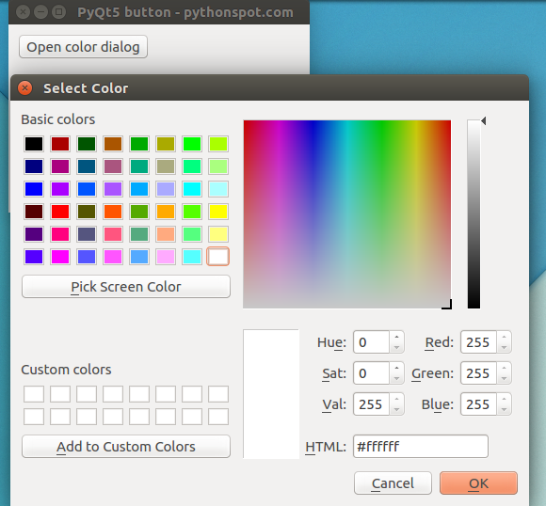
QColorDialog
color = QColorDialog.getColor()
def on_click(self):
openColorDialog(self)
def openColorDialog(self):
color = QColorDialog.getColor()
if color.isValid():
print(color.name())

Slide 36
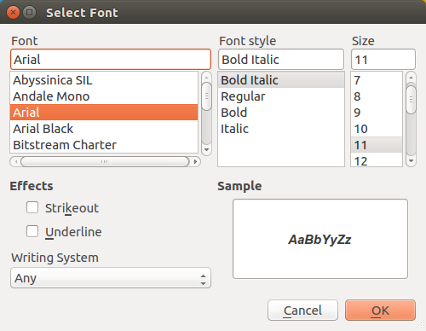
QFontDialog
QFontDialog.getFont()
def on_click(self):
print('PyQt5 button click')
openFontDialog(self)
def openFontDialog(self):
font, ok = QFontDialog.getFont()
if ok:
print(font.toString())

